Slide 1
Main Title
Descriptive Subtitle
Tim (TJ) LaFave Jr
September 21, 2022
Template_Less_Is_More_2022

Slide 2
Table of Contents |
Introduction
Things that Kind of Fly
Chickens
Turkeys
Things that Swim
Whales
Dolphins
Conclusions

Slide 3
Introduction | Things
Things swim, fly, walk, or slither.
Here, we’ll show some things that sort of fly and some other things that swim.

Slide 4
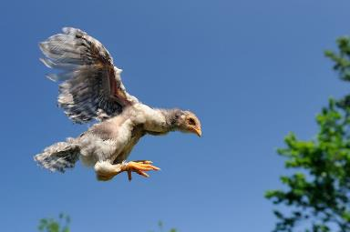
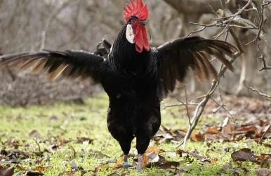
Things that Kind of Fly | Chickens
Chickens cannot really fly.
Though they try and try.

Slide 5
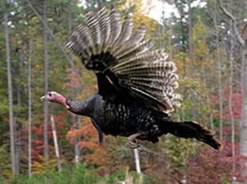
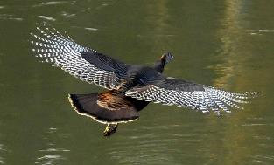
Things that Kind of Fly | Turkeys
Turkeys can fly
. . . just not very high.

Slide 6
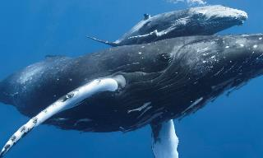
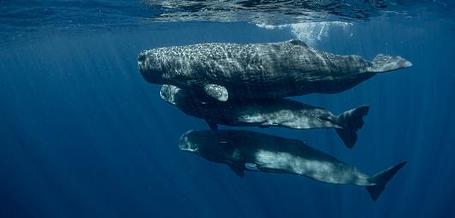
Things that Swim | Whales
Whales can swim
and swim, and swim, and swim.

Slide 7
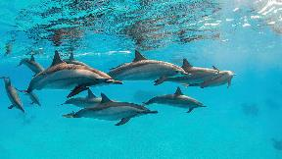
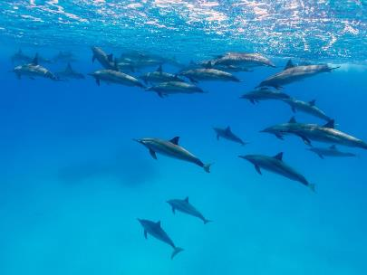
Things that Swim | Dolphins
Dolphins can swim
and swim, and swim, and swim,
and swim, and swim, and swim,
and swim, and swim, and swim,
and swim, and swim, and swim . . .

Slide 8
Conclusions |
Chickens and turkeys can kind of fly.
Whales and dolphins can swim.

