Slide 1
The Optics Library
Object Library, Tutorials, and Examples
Tim (TJ) LaFave Jr
September 30, 2022
Version 0.2 (20220930)
The_Optics_Library_UB_LaFave_20220930

Slide 2
Table of Contents
The Optics Library
Instructions
Tips & Tricks
Create Figures from PowerPoint Objects
Common Optics Blocks
Balance Detector Orientations | No Txt
Delay Stage Orientations | No Txt
Examples
Typical THz-TDS System
Stationary Sample ATM (Two Orientations)
Tip: Click logo on any page to return to Table of Contents.

Slide 3
The Optics Library | 0.75” Optics
Lenses
Apertures
THz Polarizers
Photoconductive Antennas
Microscope
Objective
Sample
EO Crystal
Mirrors
Beam splitters
Optical Fibers (w/ pigtails)
(Gold)
Parabolic Mirrors
(${90}^{∘}$ Off-Axis)
IR
VIS
or
Wollaston
Prism
THz
Pellicles
Lasers
Beams
Fiber
Couplers
Waveplates
[beam]
[fiber coupler]
[pigtail-in optical fiber]
QWPs
THz Beams
HWPs
M1
M2
Example
THz QWP
Si Prism
Miscellaneous (and In Development)
Fresnel Zone Plates
Spatial Light Modulators (gradient)
Spatial Light Modulators (binary)
Choppers
Pulse Shapes
Shutter
Balanced
Detector
Delay Stage
Beam stop
THz Buffalo

Slide 4
Instructions | Tips and Tricks 1
Quickly place objects along a beam line (e.g. as shown at right).
Highlight all the objects along the beamline, then on the Shape Format tab select Align >> Align Middle to vertically center them with respect to each other.
Click on the parabolic mirror, then press and hold the left arrow key until it aligns with the diverging THz beam.
Do the same with the PC Antenna until it aligns with the focus of the parabolic mirror on the THz beam.
Next, left-click on the IR beam. Press and hold the SHIFT key, then left-click the right tick mark to drag it to the left edge of the THz antenna.
Right-click the lens and select Bring to Front.
Note: Using the SHIFT key when dragging objects restricts them to vertical and horizontal movements. This example set up a horizontal beamline that reflects into the $y$-direction. See next page.

Slide 5
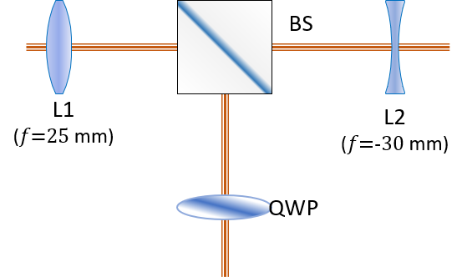
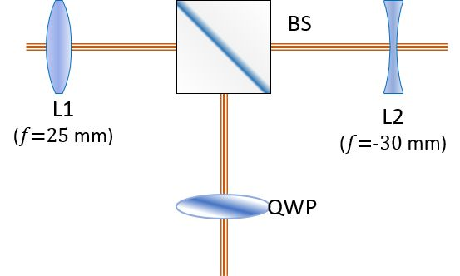
Instructions | Create Figures from PowerPoint Objects
Select all objects to the right.
Right-Click on one of the selected objects.
Click Save as Picture…
In Save As Picture dialog box, select file format
NOTE: PNG for few-color image. JPG for many-color images.
Type file name.
Navigate to appropriate directory.
Click Save.
Professional Tip: Create Transparent PNGs
Open the PNG file in IrfanView (recommended free app)
Click File >> Save AS
Select PNG as Save As Type.
Check Save Transparent Color in Options window.
Click Save.
BS
L1
($f\text{=25}$ mm)
L2
($f\text{=−30}$ mm)
QWP
Transparent PNG | (Using Irfanview)
The image here is a transparent PNG created from the objects above then converted using Irfanview.
Move this image around to see the transparency.
The little picture at bottom is the PNG saved with Powerpoint (no transparency)

Slide 6
Common Optics Blocks | Balanced Detector Orientations
Bal.
Det.
Bal.
Det.
Wollaston
Prism
$$λ/4$$
Wollaston
Prism
$$λ/4$$
M6
M6
M7
M7
Bal.
Det.
Bal.
Det.
Wollaston
Prism
$$λ/4$$
Wollaston
Prism
$$λ/4$$
M6
M6
$$λ/4$$
$$λ/4$$
Wollaston
Prism
M7
M7
Wollaston
Prism
Bal.
Det.
M6
Bal.
Det.
M6
M7
M7

Slide 7
Common Optics Blocks | Balanced Detector Orientations (no TXT)

Slide 8
Common Optics Blocks | Delay Stage Orientations
Delay Stage
Delay Stage
M3
M3
M2
M3
M1
M4
M2
M3
M2
M2
Delay Stage
Delay Stage
M4
M1
M1
M4
Delay Stage
M3
M2
M1
M4
M2
M3
M2
M3
Delay Stage
Delay Stage
M2
M3
Delay Stage

Slide 9
Common Optics Blocks | Delay Stage Orientations (no TXT)

Slide 10
Example | Typical THz-TDS System
PM2
PM3
Microscope
Objective
EO
Crystal
Antenna
Sample
Pellicle
M10
M7
PM1
PM4
M2
$$λ/4$$
M5
PBS
M6
Delay Stage
Wollaston
Prism
$$λ/2$$
M3
M4
Bal.
Det.
Ti:Sapph
Laser ($λ\text{=}800$nm)
M8
M1
M9
FIGURE. A typical THz time domain spectroscopy (THz-TDS) system. HWP=Half waveplate, PBS=polarizing beamsplitter, M=mirror, PCA= photoconductive antenna, PM=parabolic mirror, QWP=quarter waveplate.
Currently shown on Wikipedia: https://en.wikipedia.org/wiki/Terahertz_time-domain_spectroscopy

Slide 11
Instructions | Create Figures from PowerPoint Objects

